Slide 1

Predicting King County Home Prices
By Roshnee Raval
June
2019

Slide 2

Why is predicting King County home prices so important?
Their market is shifting from a seller’s market to a buyer’s market and their homes are seeing dips of 3-6% [2].
A surge of millennials will be buying their first home within the next decade [3].
A home purchase can be the largest purchase of a lifetime.

Slide 3

Who is this important to?
Anyone who is a prospective home buyer or seller
Real Estate Agents
Appraisers
Mortgage Brokers
Lending Institutions
Tax assessors
King County Officials

Slide 4

Data Wrangling
https://www.kaggle.com/harlfoxem/housesalesprediction
Original dataset is from King County public domain and includes 21,613 observations with 19 housing features from May 2014 to May 2015.
Data is tidy and contains no missing features!
70 zip codes from 108 total zip codes in King County are represented.
Dataset was in a computer friendly form and did not need to be melted.
Only one feature, id, was dropped.

Slide 5
Correlation List
price 1.000000
sqft_living 0.702035
grade 0.667434
sqft_above 0.605567
sqft_living15 0.585379
bathrooms 0.525138
view 0.397293
sqft_basement 0.323816
bedrooms 0.308350
lat 0.307003
waterfront 0.266369
floors 0.256794
yr_renovated 0.126434
sqft_lot 0.089661
sqft_lot15 0.082447
yr_built 0.054012
condition 0.036362
long 0.021626
zipcode -0.053203
Which Features have the highest correlation with home price?

Slide 6
What are the features used in house price prediction?
Target variable: Price
Latitude
Longitude
waterfront
Sqft_living
view
floors
Sqft_lot
Sqft_lot15
basement
date
Bedrooms
condition
zipcode
Sqft_above
Grade
Sqft_living15
Yr_built
Bathrooms
Yr_renovated

Slide 7

Correlation List
price 1.000000
sqft_living 0.702035
grade 0.667434
sqft_above 0.605567
sqft_living15 0.585379
bathrooms 0.525138
view 0.397293
sqft_basement 0.323816
bedrooms 0.308350
lat 0.307003
waterfront 0.266369
floors 0.256794
yr_renovated 0.126434
sqft_lot 0.089661
sqft_lot15 0.082447
yr_built 0.054012
condition 0.036362
long 0.021626
zipcode -0.053203
Which Features have the highest correlation with home price?

Slide 8
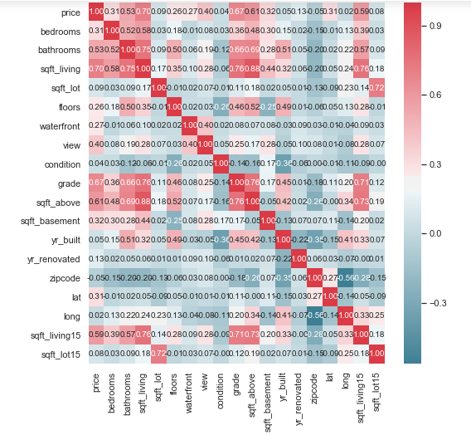
Correlation Heatmap Notice Anything Interesting?

Slide 9
Answers
Sqftliving, grade, sqftabove, sqftliving15 and bathrooms are the most highly correlated with price.
High correlation on heatmap between number of bathrooms and sqft_living
High correlation between grade and sqft_living (According to publication, this could be due to new homes being built larger[4]).
An interesting strong negative correlation between number of floors and building condition(According to publication, this could be due to two story homes requiring more repairs[5]).

Slide 10
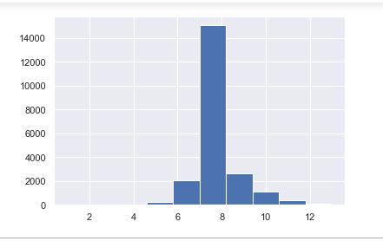
Building Grade Histogram
2nd Highest Correlation with Price
Histogram shows mean building grade = 7.5
Interesting finding since building grade of 6 barely meets King County code and 7.5 is not too far above that

Slide 11
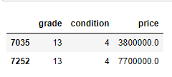
Out of the 21,613 observations how many homes do you think have the highest building grade and condition rating 4?
Grade=overall building construction and adherence to building code.
Condition=functionality of things such as painting, roofing, plumbing, or heating.
Only Two!

Slide 12
Trivia:
1.) How many homes were there with both highest building grade of 13 and highest building condition of 5?
ZERO!
2.) From 21,613 homes, how many total homes had building grade of 13?
THIRTEEN
3.) From 21,613 homes, how many had building condition rating of 5?
1,701
4.) What type of correlation did grade and condition have on the correlation heatmap?
NEGATIVE CORRELATION
5.) What might this suggest?
This might suggest that grade is a high predictor of price due to there being a limited supply of high building grade homes in King County.

Slide 13

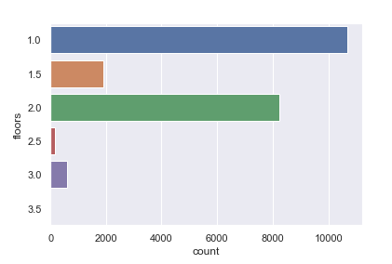
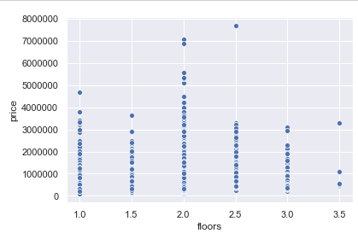
There was a negative correlation between floors and home condition, but does this mean that the majority of King County homes have one floor and how important are floors as a home price predictor?

Slide 14
The majority of homes in King County have one floor.
This may not apply to all counties in Washington since according to a publication, 69% of pacific state homes have two bedrooms[6].
This discrepancy in King County, could be due to the county's building codes or the high cost of construction in King County[7].
Floors do not have a strong correlation with price since the scatterplot shows that one floor can have the same price as multiple floors.

Slide 15
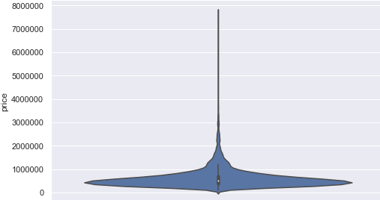
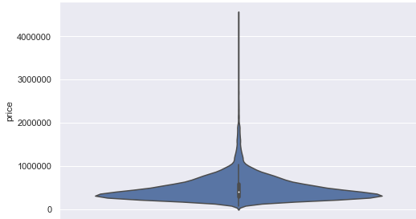
Will the violin plots for homes with a basement and without a basement look similar and if the mean home price with a basement is 622,373 dollars and without a basement is 486,884 dollars does this mean having a basement is correlated with home price?

Slide 16
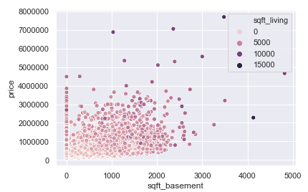
The violin plots look different in size since the number of King County homes without a basement, 13,126, far exceeds the number of homes with a basement, 8,487. According to kingcounty.gov, this may be due to the constant rain in the winter causing a less stable soil composition[8] .
Even though the median home price without a basement,411,500 dollars, is lower than that with a basement, 515,000 dollars, what does the scatterplot show about the correlation of basements, sqft_living and home price?

Slide 17
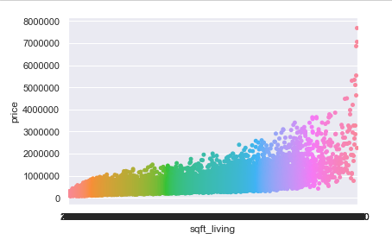
The previous scatter plot showed that basement may not be the best predictor of home price but rather that the increase in price seen in homes with basements is due to the increased sqft_living. What does the bee swarm plot show?
There is a very strong correlation between sqft_living and price!!

Slide 18
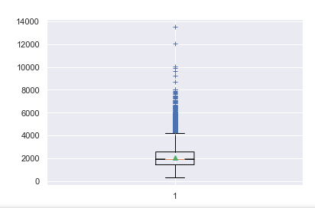
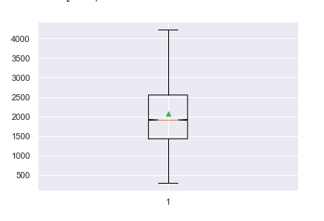
Will the box and whisker plots for sqft_living medians look similar with and without outliers?
The box and whisker plots for sqft_living look similar and the median square foot living area of 1,910 aligns closely with the calculated mean square foot living area of 2,079.

Slide 19
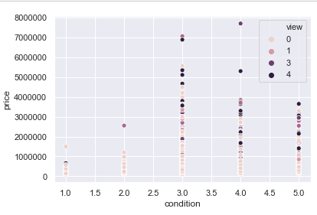
Is there any correlation between how many views a home gets from prospective home buyers and the home’s price? Does the condition of the home affect how many views a home gets?

Slide 20
What trends are seen on the scatterplot?
The first trend is that the number of views of prospective home buyers is highest when the price of the home is the highest. Since views appear equally distributed between condition ratings of 3, 4 and 5, higher priced homes with mediocre building conditions may have other attributes such as good school systems or proximity to work that outweigh the building condition for the home buyer.
The second trend shows high views of lower priced homes in good condition. This makes sense since the home buyer may be concerned with both the condition of the home and the cost-effectiveness.

Slide 21
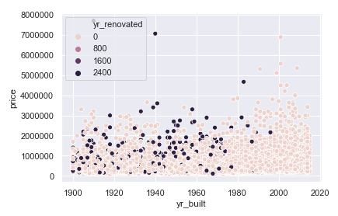
Are yr_renovated or yr_built good predictors of home price?

Slide 22
What interesting findings did the scatterplot show?
Homes built in the early 1900's in King County can be just as highly priced as those built in the 2000's. The reason for this, according to Seattle Times, could be, "The number of homes on the market is at a low point, despite the big increase in population"[9]
The majority of home renovations are done on homes built before the 1980’s.
Yr_renovated does not show much correlation with home price even though yr_built does show a slight correlation.

Slide 23
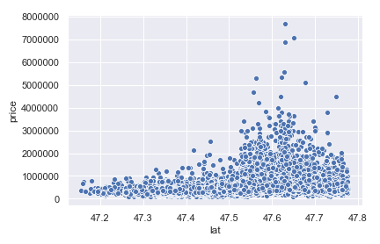
Is latitude a good predictor of home price?

Slide 24
The scatter plot shows the highest priced homes lie within the latitude of 47.6 which includes the cities of Seattle, Medina and Bellevue, WA and is home to Amazon, Bill Gates and T-mobile!
The latitude of 47.7 includes the second largest group of highest priced homes and contains the cities of Kirkland and Redmond,WA and is home to Google and Microsoft!
This also agrees with King County house price trends in those areas[10].

Slide 25
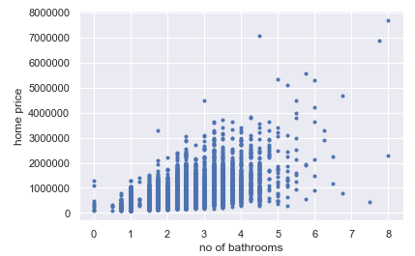
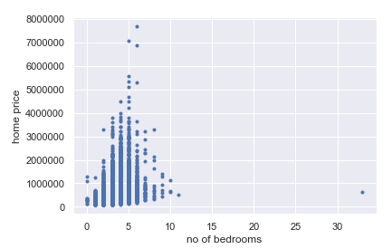
Home buyers look at both the number of bedrooms and number of bathrooms but which feature is a better predictor of home price?

Slide 26
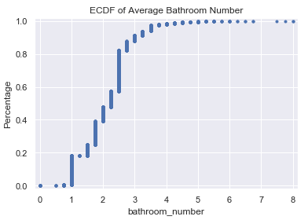
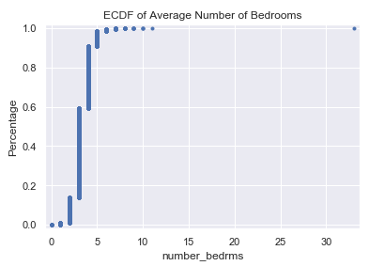
Although there is a direct correlation between home price and bathrooms, what's interesting is that after 3.5 bathrooms, the home prices levels off. Price and number of bedrooms only appears correlated up to about 5 bedrooms and is overall not strongly correlated with price. What will the ECDF tell us about the average number of bedrooms and bathrooms in King County homes?

Slide 27
The 1st ECDF function shows that the 50% probability mark for the number of bathrooms falls around 2 which aligns with the calculated mean of 2 bathrooms.
The 2nd ECDF function shows that the 50% probability mark for the number of bedrooms falls around 3 which also aligns with our calculated mean of 3 bedrooms.
The [‘year’] column was added to the dataset to separate out the 2014 from the 2015 homes. Do you think we will see any difference, on the ECDF functions, in home prices between 2014 and 2015?

Slide 28
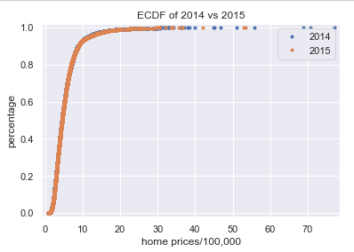
The ECDF functions for 2014 and 2015 surprisingly overlap! Thus, the 50% probability mark for home price in 2014 was about the same as that in 2015. In conclusion, [‘date’] and [‘year’] may not the best predictors of home price.

Slide 29
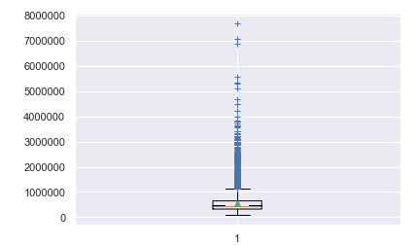
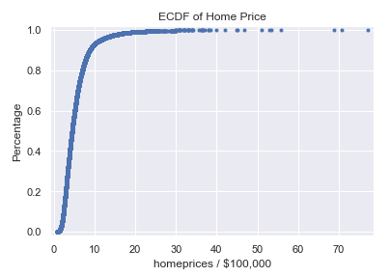
How does the mean home price compare with the median home price and does this raise any concerns about outliers in the dataset?
Plotting the home price on the ECDF plot shows us that the 50% probability mark falls around 500,000 dollars which seems to align well with both the mean home price of 540,088 dollars and the median home price of 450,000. The box and whisker plot does show some home price outliers and we will do some hypothesis testing in order to help decide if we need to remove those.

Slide 30

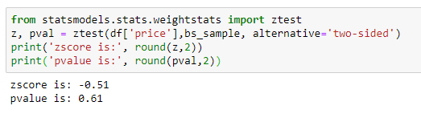
null hypoth: diff of means between full data sample and bootstrap random data sample = 0
alt hypoth: diff of means between full data sample and bootstrap random data sample != 0
Based on the p-value of >.05, we can fail to reject the null hypothesis and conclude there is no statistical difference between the mean of our bootstrap sample and the mean of our housing price data set.

Slide 31
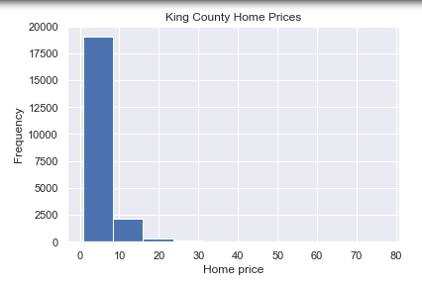
So should we remove the higher priced homes from the dataset?
Even though all three different hypothesis testings revealed no statistical difference in the means, the standard deviation was found to be large indicating that there is a high degree of variability of some data points from the mean. Does the histogram of home prices agree with this and appear skewed?

Slide 32
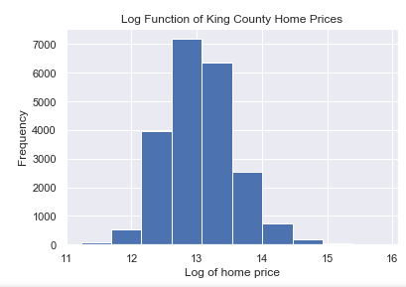
Since the home prices do appear skewed, let’s see if taking the logarithmic function normalizes the home prices before we remove the higher priced homes from the dataset:
The histogram above shows a considerable improvement in distribution by taking the log of home prices!

Slide 33
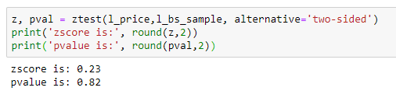
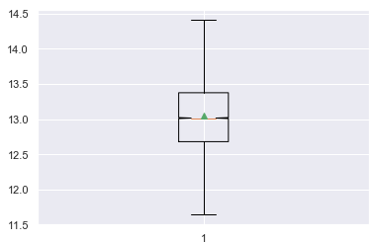
What was the result of hypothesis testing after taking log function on home prices?
The p value greater than .05 indicates that there is not a statistical difference between the log of the home price mean and the log of the bootstrap home price mean.
The log of the mean home price,13.05, and the log of the median home price,13.02, shows an improved central tendency and the box and whisker plot also shows an improved distribution. In conclusion, we will not remove the higher priced homes from the dataset but rather utilize the logarithmic function on home price values.

Slide 34

Supervised Machine Learning
Regression machine learning algorithms are chosen, since the response being predicted, home price, is ordered and continuous. How will the linear regression model do with the four highest correlated features?

Slide 35
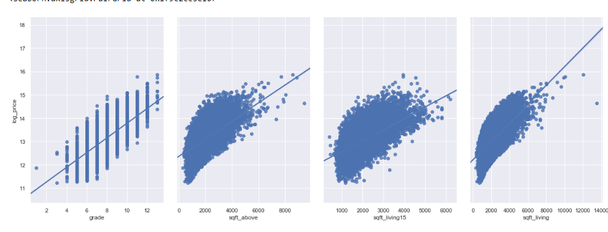
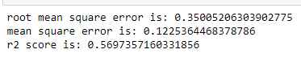
Even though the scatter plots show strong correlation between these features and home price, the R^2 value is only 0.56 with cross-validation score of 0.57.
Will utilizing OLS stats such as R^2, AIC and BIC select different features that will improve the model’s performance at predicting home prices?

Slide 36
What did OLS regression results show?
The features with AIC/BIC values that showed weak price predictors were: 1.)bedrooms 2.)year 3.)floors 4.)sqft_basement 5.)yr_renovated
The features with almost zero R^2 value were: 1.)long 2.)zipcode 3.)year 4.)yr_renovated
The highest R^2 value features were: 1.)grade 2.)sqft_living 3.) sqft_above 4.)sqft_living15
The features chosen were: 1.)grade 2.)sqft_above 3.)sqft_living 4.)sqft_living15 5.)bathrooms 6.)lat 7.)view

Slide 37
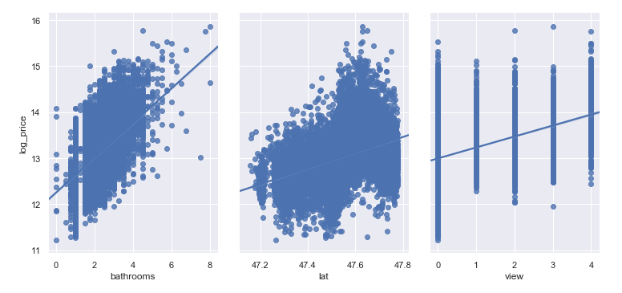
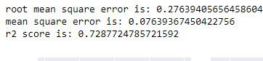
How did the linear regression model with 7 total features do?
1.)grade 2.)sqft_above 3.)sqft_living 4.)sqft_living15 5.)bathrooms 6.)lat 7.)view
Adding in more high R^2/low AIC/BIC features definitely improved the model! Will using the sklearn feature selection method improve the model further?

Slide 38
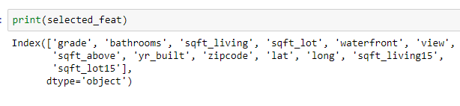
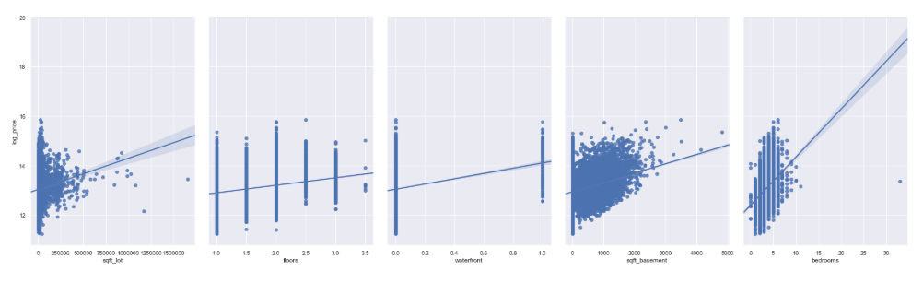
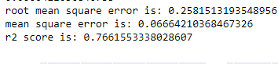

Which features did sklearn feature selection select?
How did the model of 14 total features perform and anything interesting found?

Slide 39
Which features did sklearn feature selection remove?
bedrooms, year, floors, sqft_basement, and yr_renovated
Does this make sense that these features were removed? Any concerns so far?
Year, yr_renovated, floors and bedrooms agreed with our previous visualizations and stats of not being the best predictors of home price.
In our earlier visualizations, it was unclear whether sqft_basement was correlated with price or to other factors such as larger home size.
The sklearn feature selection removal of sqft_basement is an important finding since it not only indicates that there are not a lot of homes in King County with a basement, but also that sqft_basement is not a significant home price predictor in King County.
All location-related features were important to the housing price prediction model which means the ol' real estate adage about location may be correct!

Slide 40
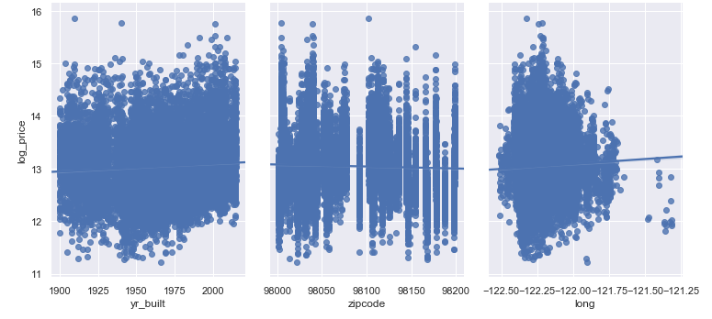
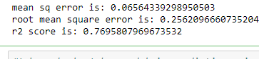
Will combining features from both sklearn selection, R^2, AIC/BIC, pvalue, coefficients, RMSE, MSE, and cross-validation improve the model even further?
This was the best model so far!
What were some interesting findings from the linear regression machine learning model?

Slide 41
Linear Regression Model Conclusions:
[grade, bathrooms, bedrooms, sqft_living, sqft_lot, floors, waterfront, view, condition, yr_built, zipcode, sqft_basement, lat, long, and sqft_living15] were the 15 features utilized.
[year and yr_renovated] were removed via sklearn feature selection method.
[sqft_lot15 and sqft_above] were removed via R^ 2, mean squared error, root mean squared error, coefficients and OLS analysis.

Slide 42
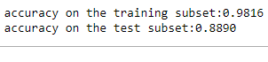
What were the results of Random Forest Regressor Model?
Similar to the linear regression model, the 15 features combining stats analysis and sklearn feature selection method gave the best home price prediction on the Random Forest Regressor model.

Slide 43
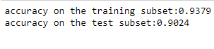
What were the results of the Gradient Boosting Regressor Model?
In comparing the linear regression model, random forest regressor and gradient boosting regressor, the gradient boosting regressor is the classifier that gave us the highest score of 93% and 90% respectively on the training and test model.

Slide 44
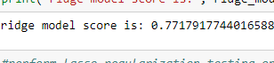
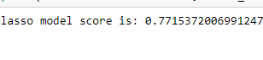
What were the results of the Ridge and Lasso Regularization testing?

Slide 45
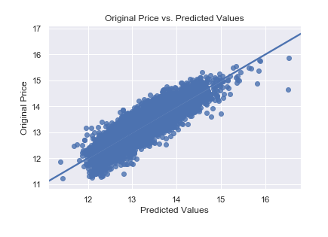
How did the original vs predicted price values plot look?
The model is performing great!

Slide 46
Conclusions
A total of 15 features were utilized from our original dataset of 20 features.
Even though sqft_living and building grade were important features to the housing price prediction model, the following features did not have as much impact and were eliminated(year, yr_renovated, sqft_above and sqft_lot15).
Even though sqft_basement, floors and bedrooms were kept as features, they were not found to be high predictors of home price in King County.
The location based features (zipcode, lat, long) had a surprisingly large impact on the machine learning models as removing them significantly reduced the model's ability to predict home prices!

Slide 47

THANK YOU!
In conclusion:"There are three things that matter in property: Location,Location, Location!"-quote by Harold Samuel
By: Roshnee Raval

Slide 48
References:
Springboard Mentor: Harsh Vardhan Singh
[1] https://www.kaggle.com/harlfoxem/housesalesprediction
[2]https://www.seattletimes.com/business/real-estate/seattle-area-home-prices-drop-to-lowest-point-in-two-years-down-116000-since-last-spring/
[3]https://www.forbes.com/sites/alyyale/2018/12/06/2019-real-estate-forecast-what-home-buyers-sellers-and-investors-can-expect/
[4]https://www.nytimes.com/2016/06/04/upshot/houses-keep-getting-bigger-even-as-families-get-smaller.html)
[5]https://www.doityourself.com/stry/the-extra-costs-of-2-story-homes
[6]https://magazine.realtor/daily-news/2016/08/08/one-vs-two-story-homes-which-dominates
[7]https://www.boardandvellum.com/blog/cost-of-construction-in-seattle/
[8]https://kingcounty.gov/~/media/depts/dnrp/solidwaste/ecoconsumer/documents/SeattleTimes_2013-07-26.ashx?la=en
[9]https://www.seattletimes.com/business/real-estate/why-are-seattle-area-home-prices-so-high/
[10]https://gismaps.kingcounty.gov/iMap/

